Slide 1
Cluster analysis in CA cities
Wendy Wen

Slide 2
Introduction
Scenario: pick a city in CA to move in assumed you do not have financial constraint.
Approach: unsupervised learning with cluster analysis

Slide 3
DATa
3 data source:
Big city venue data from foursquare.com by locations:
https://www.w3.org/2003/01/geo/test/ustowns/latlong.htm
Crime data:
https://en.wikipedia.org/wiki/California_locations_by_crime_rate
Income data:
https://en.wikipedia.org/wiki/List_of_California_locations_by_income

Slide 4
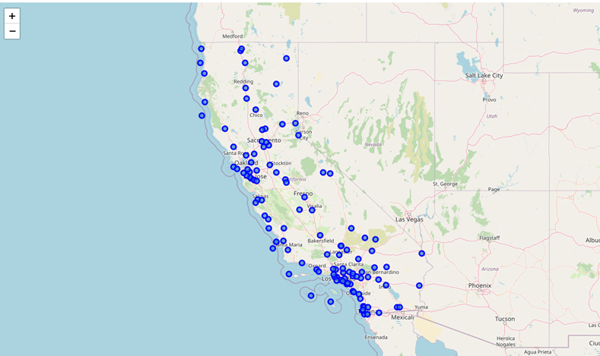
Exploratory analysis
Location distribution: all the big cities are included in the analysis
The location latitude and longitude are used to get the venue data from Foursquare.

Slide 5
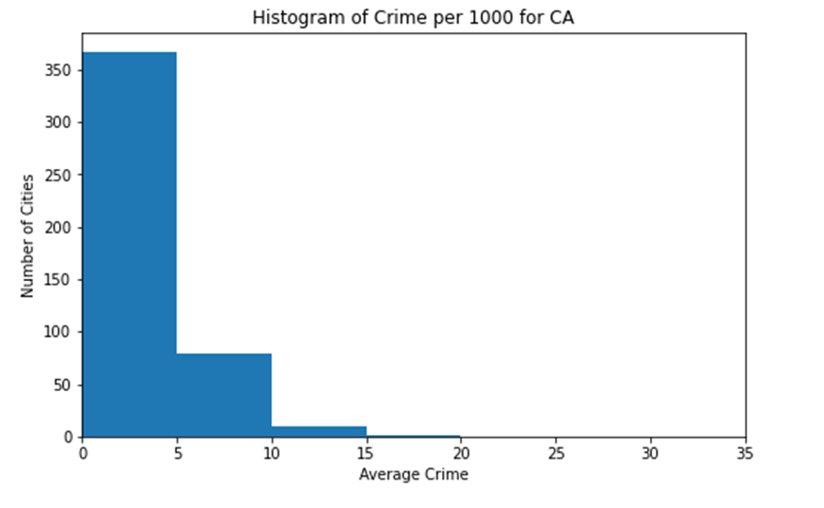
Exploratory analysis
Crime rate: The crime rate is not normally distributed, with most cities have low crime rate and a few outliers.

Slide 6
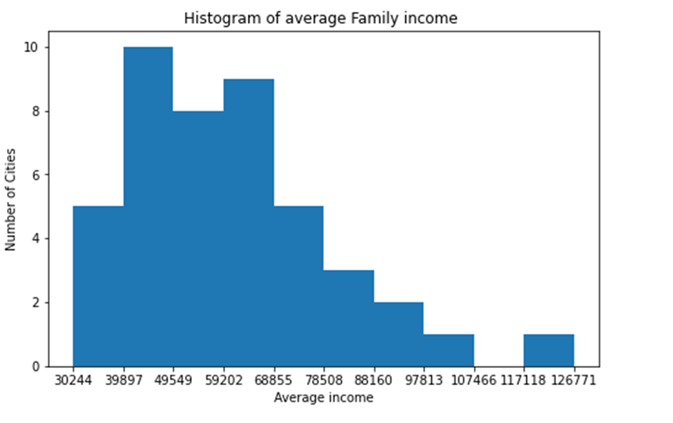
Exploratory analysis
Family Income: The family income looks more normally distributed.

Slide 7
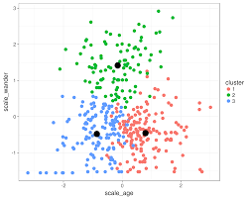
Machine learning
Unsupervised learning algorism.
K-means cluster analysis was used for all the data.

Slide 8
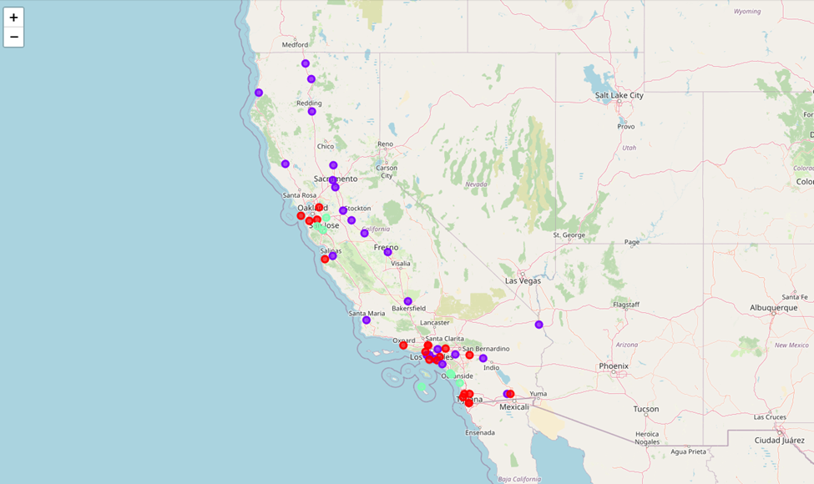
Result and Discussion
3 clusters are formed based on the 3 metrics.

Slide 9
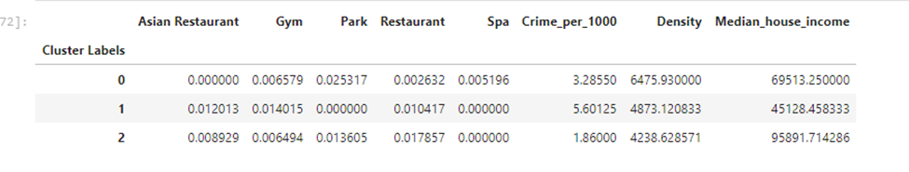
Result and Discussion
The metrics separate 3 groups well.
Cluster 2 has the highest income and lowest crime rate.

